Slide 1

LOCAL ACTION GROUP (LAG) L’ALTRA ROMAGNA
EUROPA FORUM
27 JUNE 2025
THE BEST PRACTICES OF LAG L’ALTRA ROMAGNA

Slide 2

EUROPA FORUM 2025 THE BEST PRACTICES OF LAG L’ALTRA ROMAGNA
LAG L’Altra Romagna
Thematic Areas and Figures of the LEADER 2014–2022 Programming
The Best Practices of LAG L’Altra Romagna:
Cooperation Projects
Agreeement-Based Pojects
Direct Management Projects

Slide 3
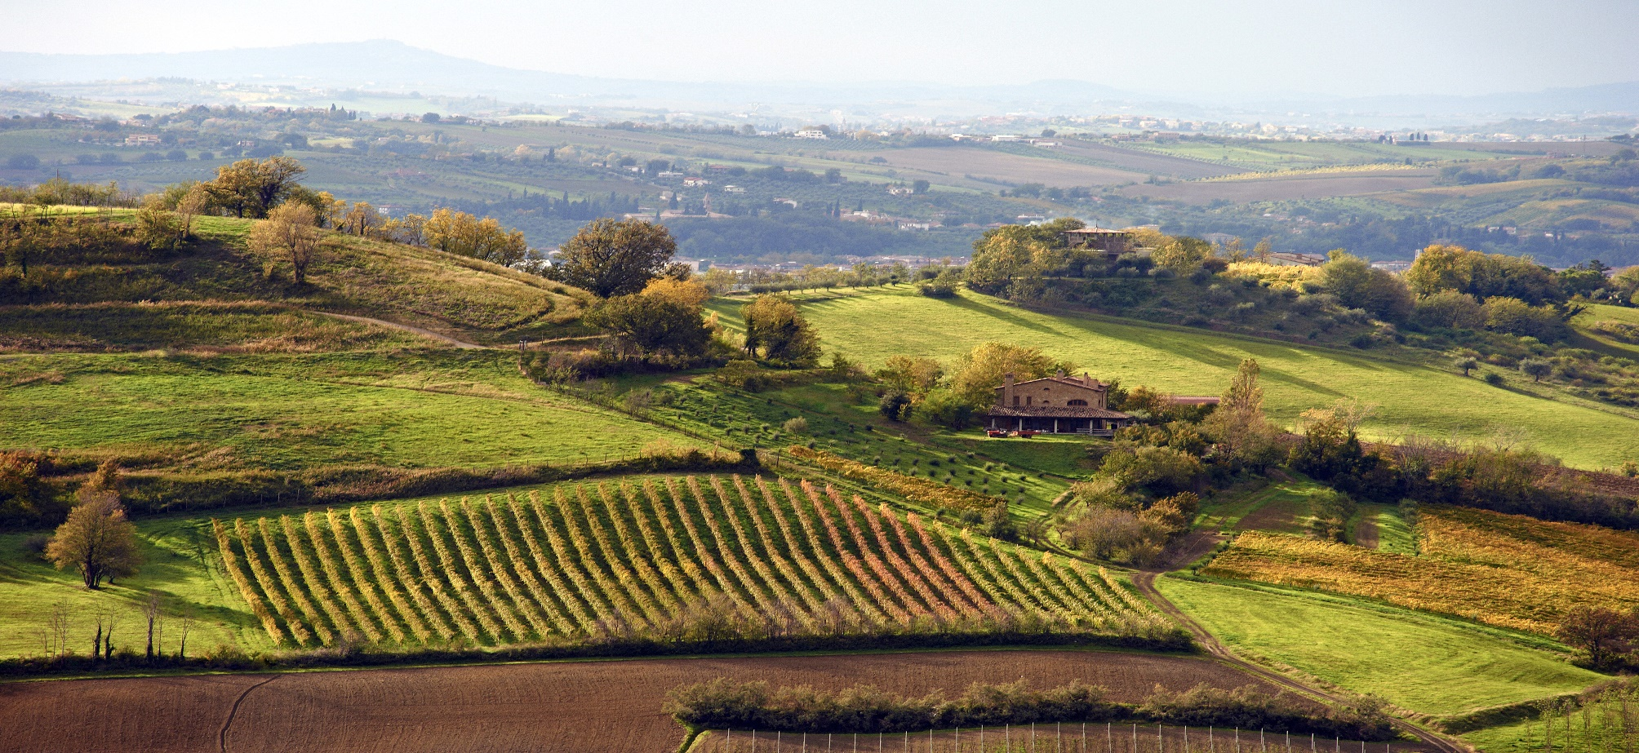
DATE OF BIRTH
Since 1992: company for territorial development to promote hills and mountains areas of the Forlì-Cesena and Ravenna provinces
L’ALTRA ROMAGNA
Since 1994: L’Altra Romagna has become a LAG (Local Action Group), engaged in the development of the Romagna area, especially those parts of this territory
Statuary Purpose
Local public-private partnership to promote the development, improvement and enhancement of the socio-economic and cultural activities of the Apennines and the Romagna area.
The objective of L'Altra Romagna is linked to the promotion and development of the hilly and mountain area of ​​Romagna.

Slide 4
Company Form
PUBLIC MEMBERS
Provincia di Forlì-Cesena
Provincia di Ravenna
Provincia di Rimini
Unione della Romagna Faentina
Unione di Comuni della Romagna Forlivese
Unione Rubicone e Mare
Unione Comuni montani Valmarecchia
Ente Parco Nazionale delle Foreste Casentinesi Monte Falterona e Campigna
Camera di Commercio della Romagna Forlì-Cesena e Rimini
CCIAA Ravenna
TOTAL PUBLIC SHARE CAPITAL € 27.243,00 (42%)
PRIVATE MEMBERS
Confederazione Italiana Agricoltori Romagna
Confesercenti Cesenate
Consorzio Promo Appennino
Associazione regionale AGCI Emilia Romagna
TOTAL PRIVATE SHARE CAPITAL € 37.757,00 (58%)
SOCIAL CAPITAL: 65.000€

Slide 5
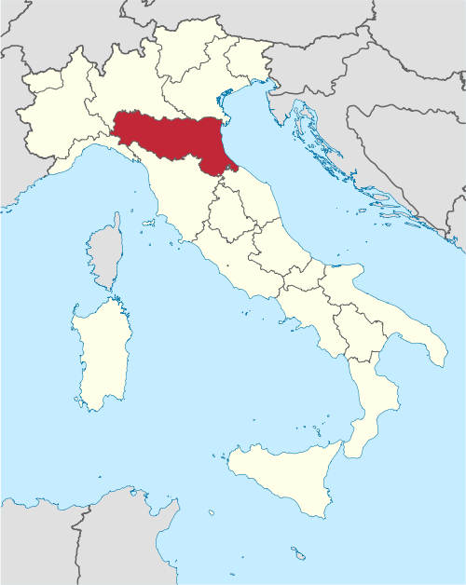
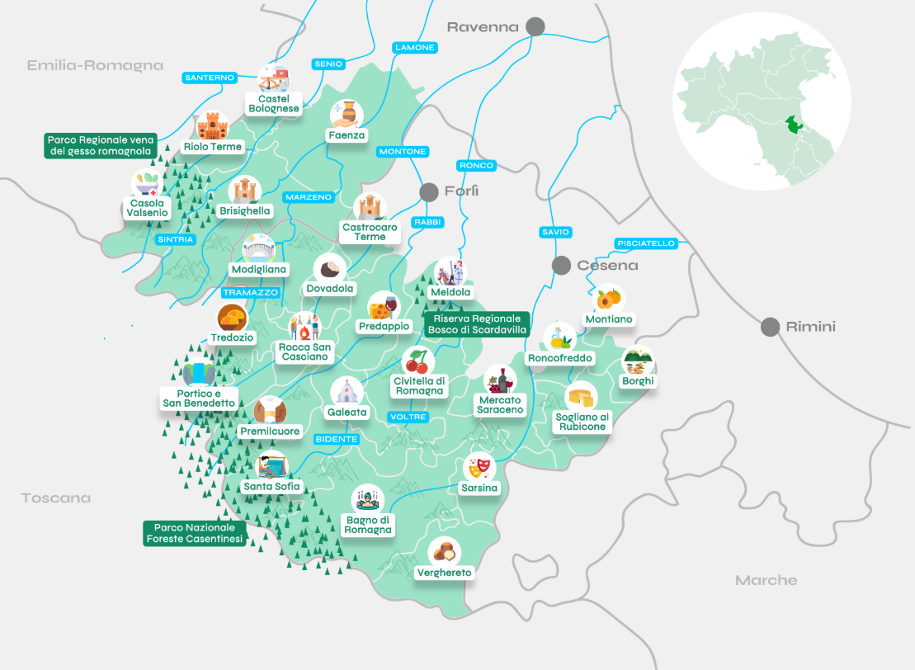
AREAS OF LAG L’ALTRA ROMAGNA
25 Municipalities
Surface: 2.115,37 Km2
Inhabitant: 103.281
Population Density: 48,82 Inh/km2
Nr.3 Natural Parks
Nr.8 Valleys

Slide 6
Thematic Areas and Figures of the LEADER 2014–2022 Programming

Slide 7
LEADER 2014 – 2022 FUNDING CALLS DATA
Thematic Area | Nr. Projects /Calls | Nr. Beneficiaries | Allocated Resources | % On the Total of Resources | On the Total Resources for the Strategy
A - Development and innovation of local production chains and systems (agri-food, forestry, artisanal and manufacturing) | 13 | 109 | 6.912.596,81 | 48 % | 59 %
B - Sustainable tourism | 6 | 24 | 3.759.865,33 | 26 % | 32 %
C - Care and protection of the landscape, land use and biodiversity (animal and plant) | 5 | 31 | 558.221,14 | 4 % | 5 %
Cooperation | 3 |  | 427.497,23 | 3 % | 4 %
TOTAL | 27 | 164 | 11.658.180,51 | 81 % | 100%
Management and Animation Expenses |  |  | 2.675.419,56 | 19 %
TOTAL |  |  | 14.333.600,07 | 100%

Slide 8
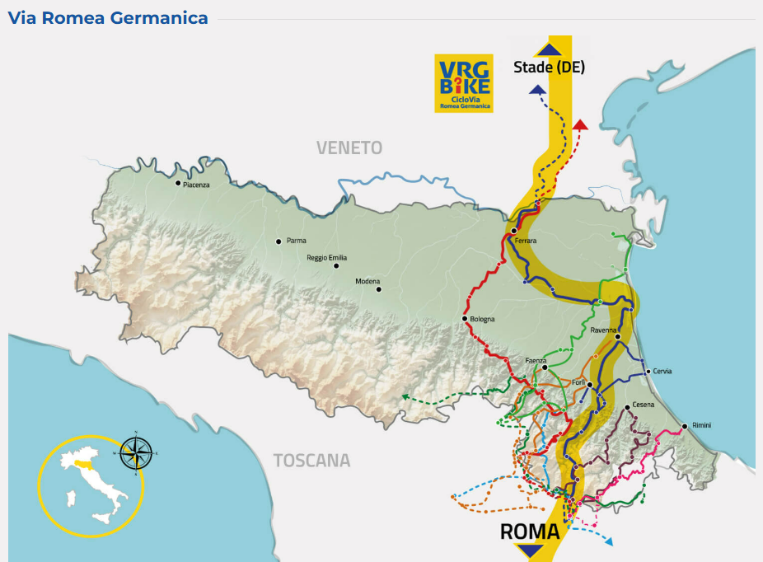

INTER-TERRITORIAL COOPERATION PROJECTS: Walking the Pilgrimage Routes from the Apennines to the Po Delta: “CAMMINI (Paths)"
Total budget EUR 875.206,00
PARTNERS: All LAG of Emilia Romagna Region
LAG Valli Marecchia e Conca;
LAG Delta 2000
LAG Del Ducato
LAG Appennino Bolognese
LAG Antico Frignano e Appennino Reggiano
Project Objective:
To organize slow tourism itineraries along the "Regional Paths" of Emilia-Romagna, actively involving the local population to transform the routes into authentic experiences and promote the economic development of rural areas.
Click here to look the map of Wayfarer's Pouch !
Visit the VRG BIKE website to reach our LAG from Northern Europe and explore all the paths of our territory by bike!

Slide 9

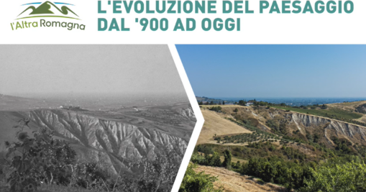
INTER-TERRITORIAL COOPERATION PROJECTS: “Landscapes to Experience” Protection and Enhancement of the Rural Landscapes of Emilia-Romagna
Total budget EUR 599.529,00
PARTNERS: All LAG of Emilia Romagna Region
LAG Valli Marecchia e Conca;
LAG Delta 2000
LAG Del Ducato
LAG Appennino Bolognese
LAG Antico Frignano e Appennino Reggiano
Project Objective:
To identify and enhance the landscape excellences of the rural areas of Emilia-Romagna through an in-depth and coordinated analysis of local landscapes, promoting sustainable and shared management.
Visit the PAESAGGI DA VIVERE website to discover all our rural landscapes.
Look the Video of our Project!

Slide 10
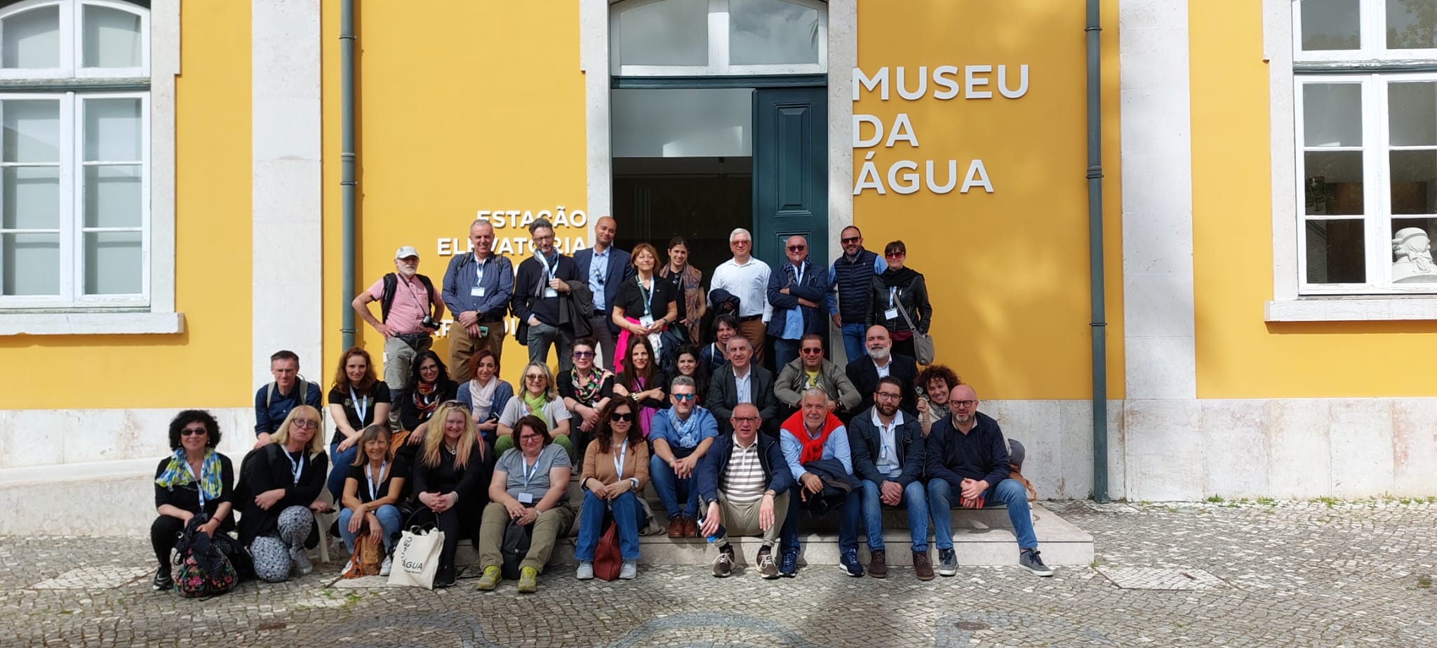
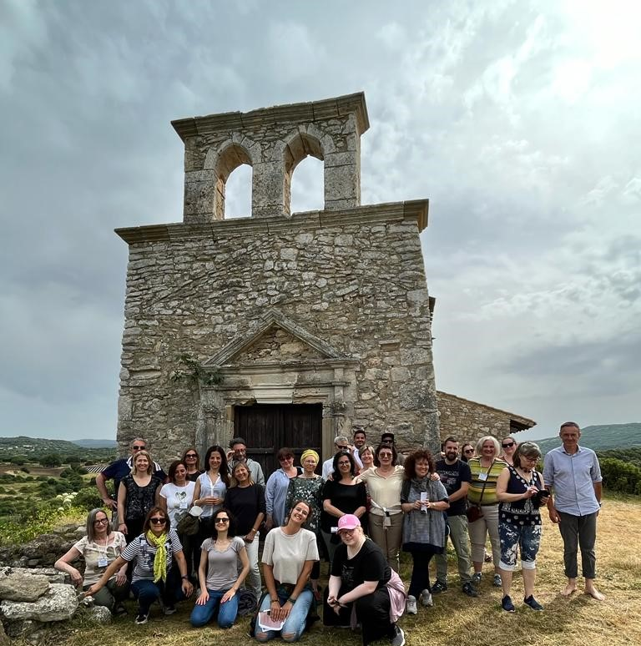
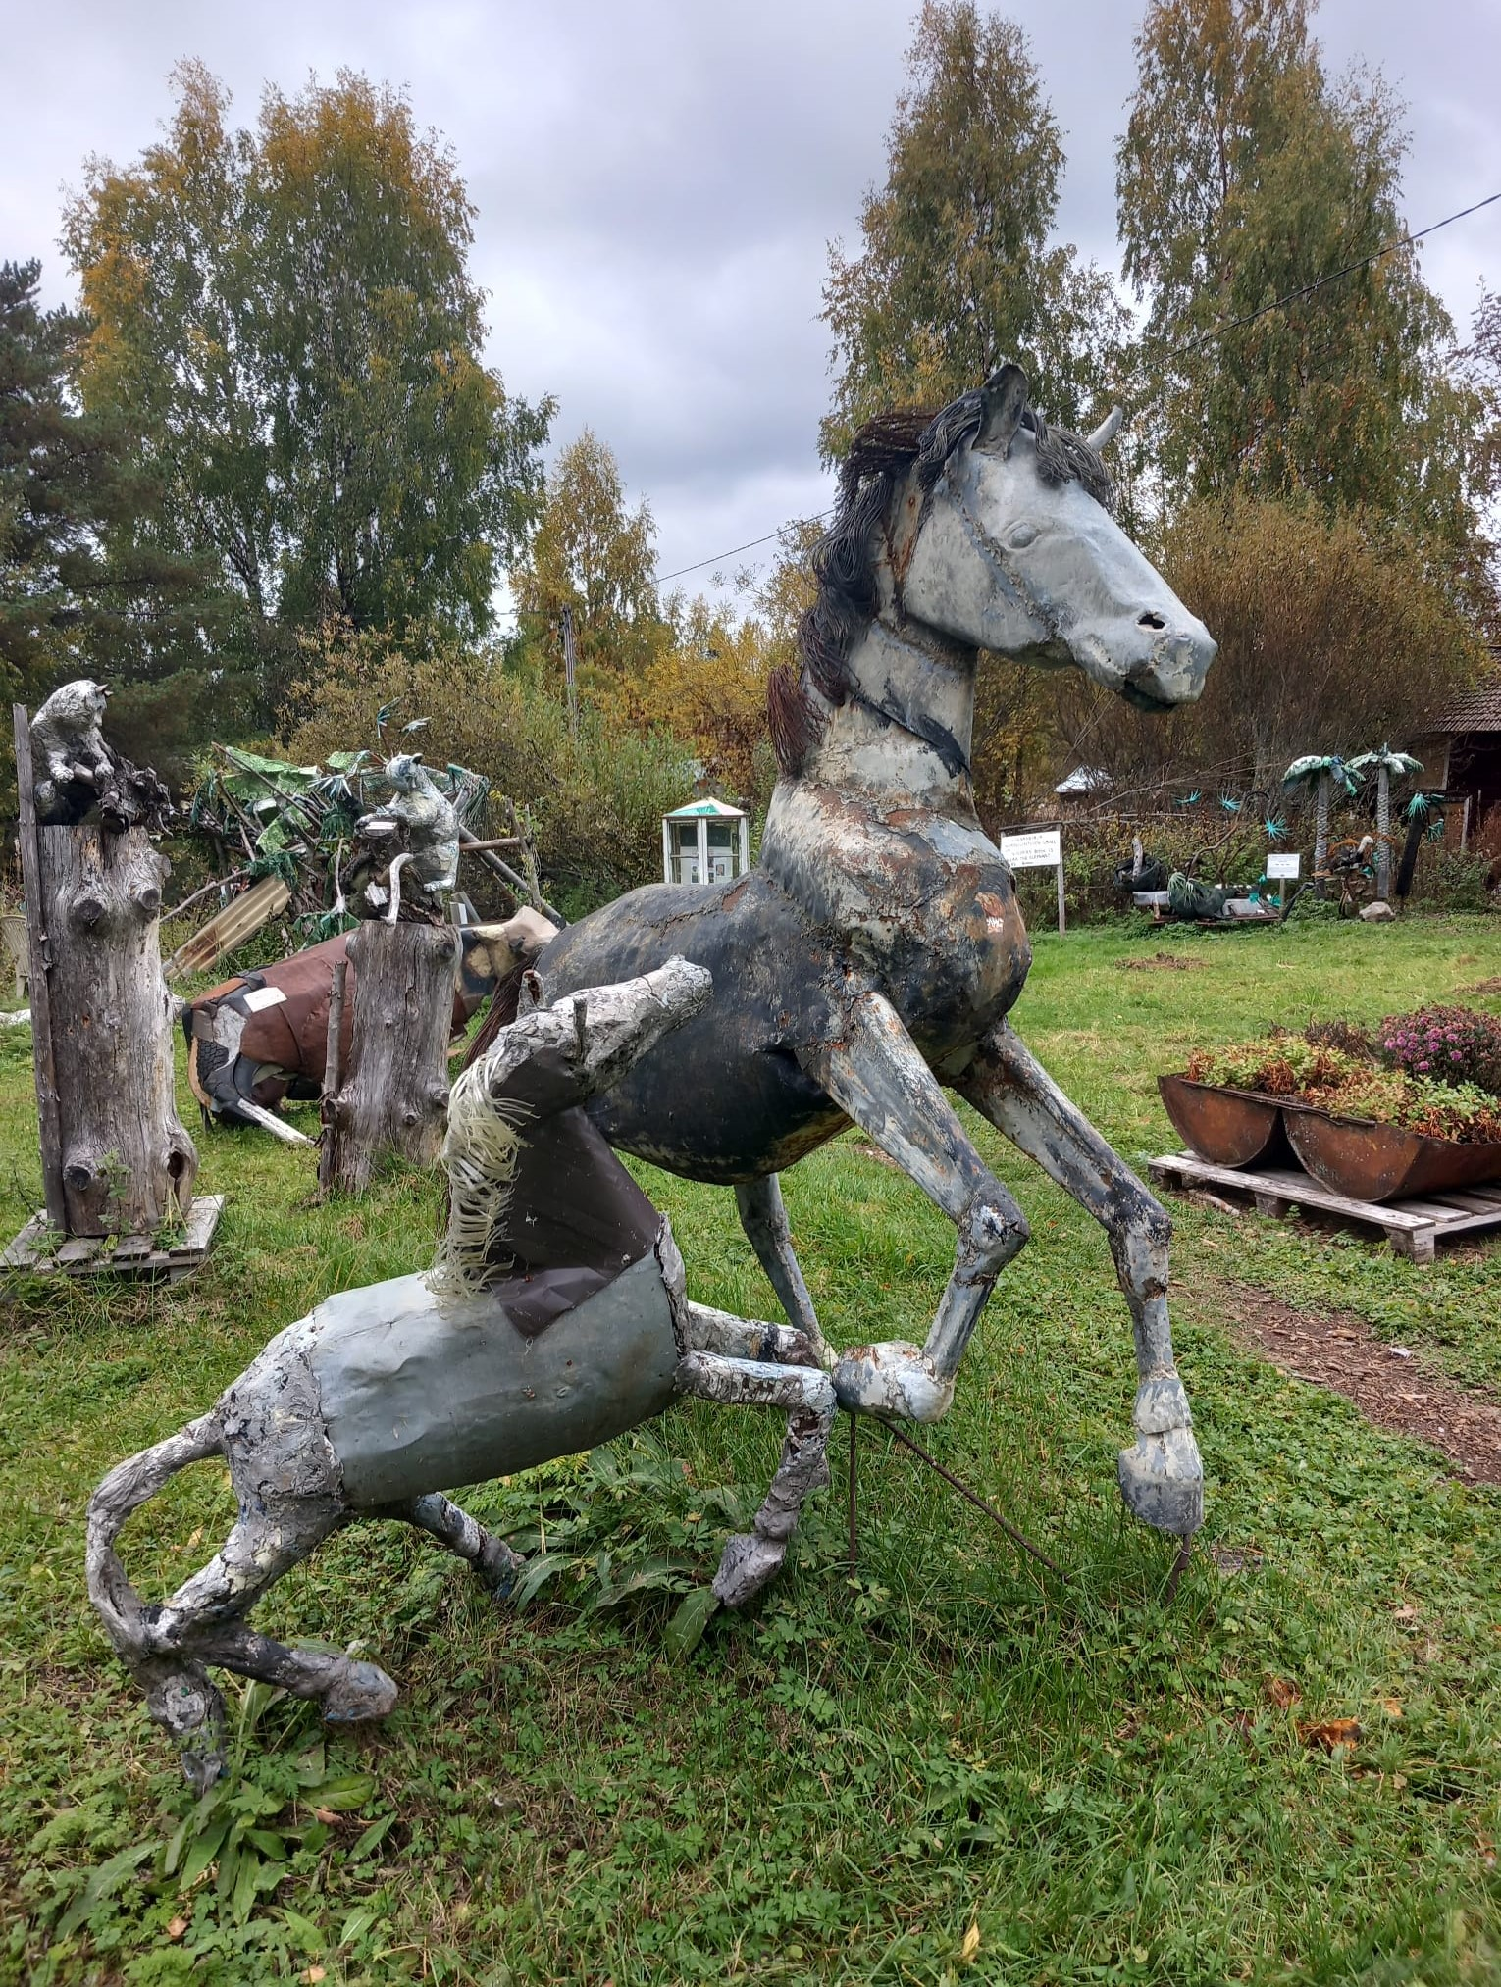
ECHOES Transnational Cooperation project Rural Development Program of Emilia – Romagna Region (Measure 19, Sub – measure 19.3)
7 Local Action Groups (4 Italian, 2 Finnish and 1 Swedish) who have started a collaboration process aimed at the growing and innovation of ecomuseums and museums representing local traditions and cultural heritage in their respective territories of competence .
ECHOES has the following objectives:
Strengthen the capacities of institutions to apply innovative models, strategies and concrete actions for the protection and sustainable use of intangible cultural heritage;
Enhance the components of the identity of a place (territory, memory, tradition and customs);
Promote new job opportunities for young people and entrepreneurship, promotion and investments through the exchange of generational knowledge
Increase knowledge of intangible cultural heritage.

Slide 11
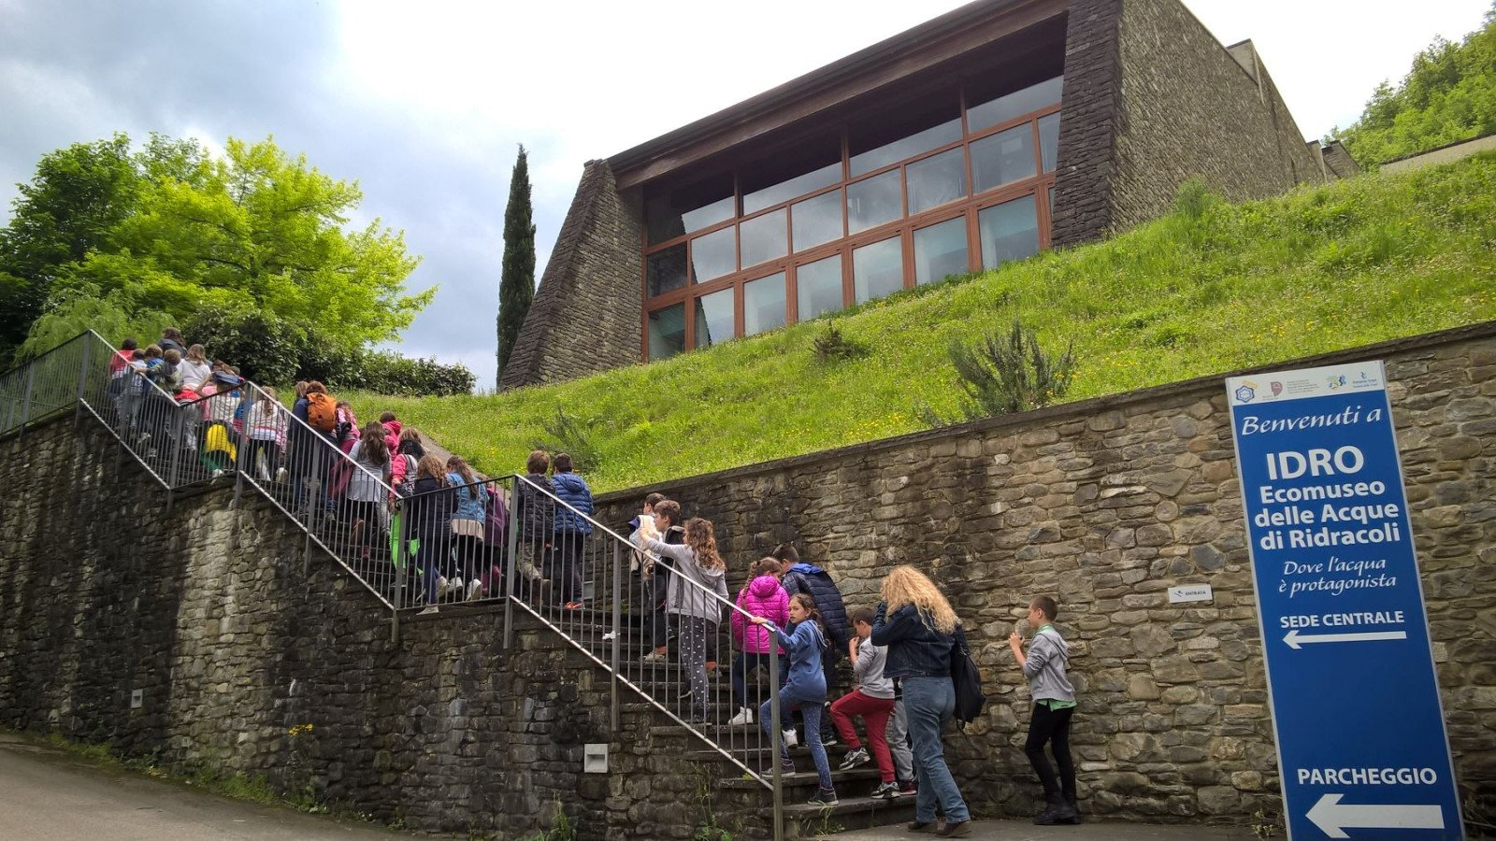
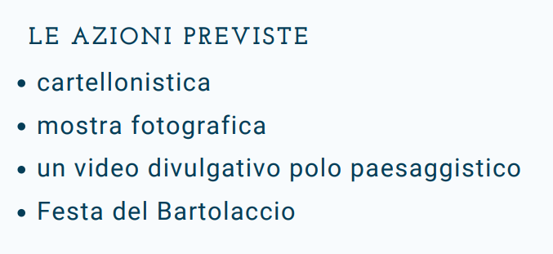
Action 3.2 Purchases of goods and services for local eco-museums
Public bodies for carrying out the action:
Romagna Acque Società delle Fonti S.p.A. intervenes at the Idro Ecomuseum of the Waters of Ridracoli

Slide 12

AGREEMENT-BASED PROJECTS: Paths and Flavors: Joint Promotion of Local Products and Services
The enhancement of the Romagna hills involves integrating hiking, local food and wine, and culture, promoting local products and services while creating new opportunities for businesses and sustainable tourism.
Activities include guided hikes with tastings, food and wine events, and initiatives to strengthen the network between producers, agritourism and tourism operators.

Slide 13

AGREEMENT-BASED PROJECTS: Biodiversity of food interest, safeguarding and recovery of traditional local cultivars from the Apennines for the development of production chains.
A journey into agricultural tradition and the richness of local biodiversity: the book “Vegetable and Cereal Varieties of the National Park and GAL L'Altra Romagna” tells the story of the value of ancient cultivars from our territory, guardians of authentic flavors and historical memory.
Thanks to thorough research, the book explores the agrobiodiversity of the hilly and mountainous Romagna, highlighting the importance of preserving traditional varieties for environmental sustainability and food security. A heritage at risk of disappearing, now valued and protected through studies, interviews, and technical sheets.

Slide 14
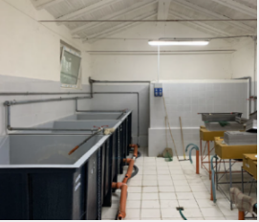
AGREEMENT-BASED PROJECTS: Waters, Kingdom of Life: The Fish Hatchery of Premilcuore
The Municipality of Premilcuore, located in the Casentino Forests, Monte Falterona, and Campigna National Park, hosts unique biodiversity, including endemic Mediterranean trout, which are the focus of conservation projects.
A tourism and educational project was created, focusing on sustainable fishing and the protection of Mediterranean trout. The project included the establishment of specialized educational hubs, a "nature trail" along the Rabbi River with informative signs and rest areas, and the creation of a fish hatchery for trout population restoration.
A regulated fishing zone was also set up to promote sport fishing and environmental control, aiming to raise awareness about local biodiversity and promote sustainable tourism.

Slide 15

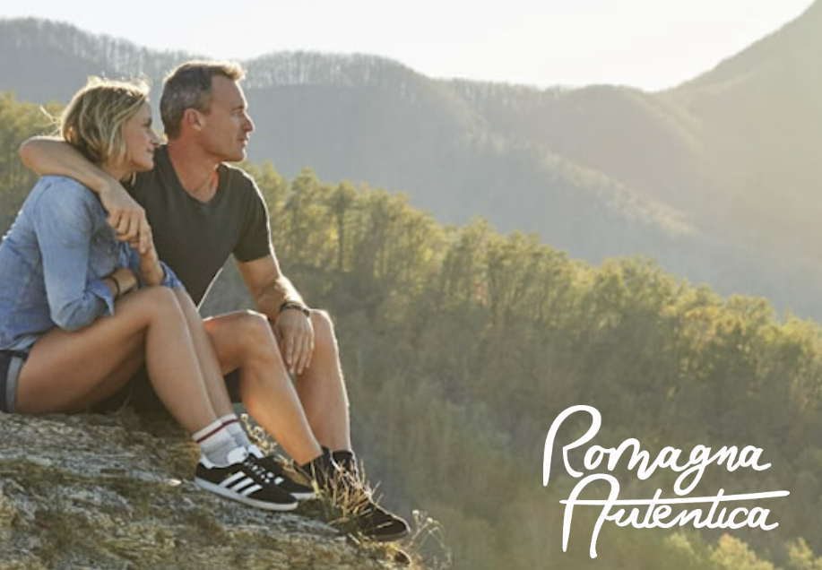
AGREEMENT-BASED PROJECTS: "Integrated Promotion of the Territory – Territorial Marketing“ ROMAGNA AUTENTICA
The "Integrated Promotion of the Territory – Territorial Marketing" project enhanced the tourism offering of GAL L'Altra Romagna, promoting an authentic image of the destination through the "Romagna Autentica" concept.
The project mapped over 150 experiences, conducted multichannel advertising campaigns, and involved tourism operators, boosting the region’s visibility and positioning it as a unique and distinctive destination.
It represents an innovative model for promoting inland areas with growth and sustainable development prospects.
Visit the ROMAGNA AUTENTICA website to discover our beautiful destinations and experiences:
Look the Video of our amazing Destination!

Slide 16

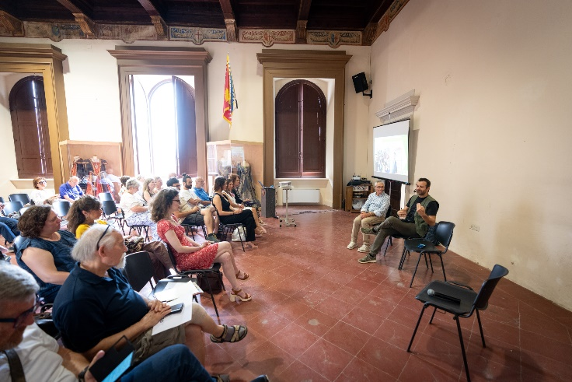
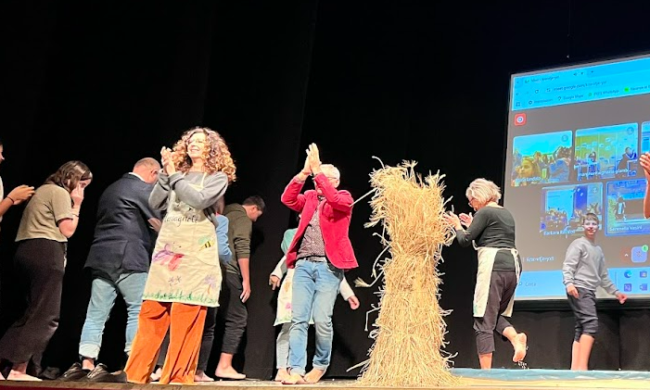
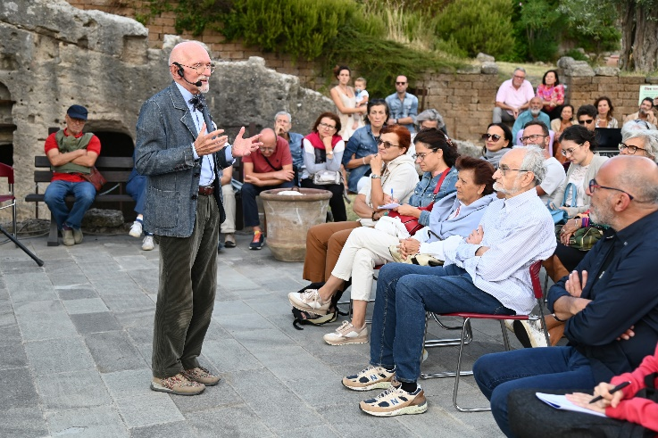
AGREEMENT-BASED PROJECTS: Well-being, Nutrition, and Healthy Lifestyles
The project aims to promote well-being through activities involving schools, citizens, and local businesses. The goal is to raise awareness on topics such as healthy lifestyles, sports, and nutrition, supporting local agricultural businesses and encouraging the development of new entrepreneurial initiatives.
The activities include events, excursions, educational workshops, and seminars, involving national experts and creating connections within the community to strengthen social cohesion and promote the territory, also through the approach to the concept of community cooperatives.

Slide 17
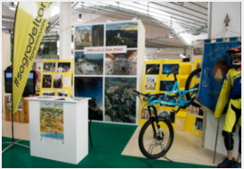
DIRECT-MANAGEMENT PROJECT: Village of L'Altra Romagna
The project aimed to promote the Romagna hinterland’s natural, cultural, historical, and food resources, focusing on the economic and social development of rural and mountainous areas.
During the "Sono Romagnolo" fair, the Village of L'Altra Romagna showcased exhibitions, cooking workshops, musical and folkloric events, and culinary competitions.
The initiative sought to attract visitors and promote sustainable tourism through village tours, tastings, and historical itineraries. The goal was to create a unified and authentic tourism offer for Romagna.

Slide 18
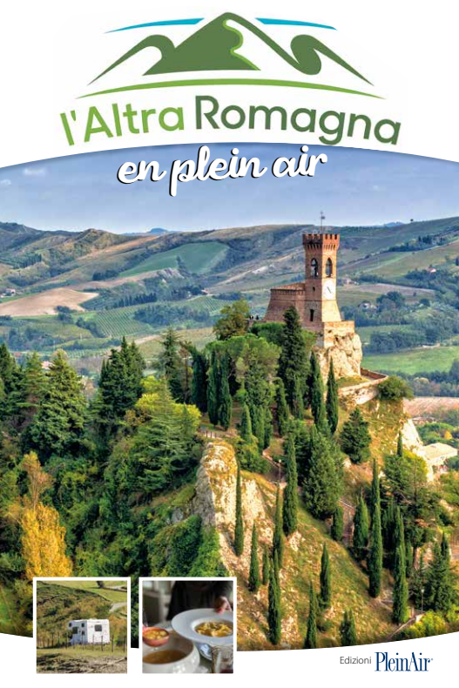
DIRECT-MANAGEMENT PROJECT: L'Altra Romagna en plein air: a territory for outdoor itinerant tourism (camper, caravan, and tents)
It is an invitation to discover the natural, cultural, and food and wine wonders of our territory by camper, caravan or tent. An authentic experience across 31 municipalities in the hinterland, combining charm, traditions, and the beauty of the places, to be enjoyed with an active spirit and outdoors.
Click here to discover and downlowd our “Altra Romagna An plain Air English Version” !

Slide 19
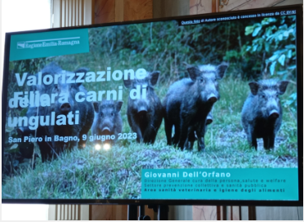
DIRECT-MANAGEMENT PROJECT: Enhancement of the Ungulate Supply Chain
The project addressed the problem of the excessive number of ungulates in mountainous areas, turning it into an economic opportunity.
A feasibility study was conducted to implement a dedicated supply chain, in connection with projects already underway in Emilia-Romagna. Local facilities were strengthened with refrigerated units for the collection and management of the meat.

Slide 20




THANK YOU FOR YOUR ATTENTION
Director: Mauro Pazzaglia
Via Roma N.24, 47027 Sarsina (FC) - Italy
info@altraromagna.net
+39 0547 698301
www.altraromagna.net

